Slide 1

Exploring Aggregation of Personal, Private, and Institutional Web Archives
Mat Kelly
Web Science and Digital Libraries Research Group
Old Dominion University
Archives Unleashed 2.0: Web Archive Datathon
Washington, DC
June 15, 2016
http://ws-dl.cs.odu.edu
@machawk1

Slide 2
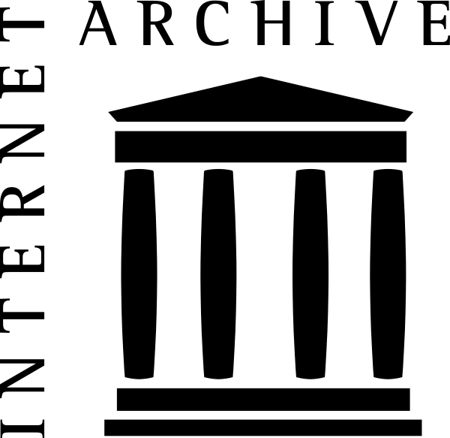





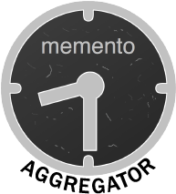

Problem
Personal and Private Captures Cannot Systematically be replayed inline with public institutional captures
other
institutional
archives
. . .
my private
archive

Slide 3
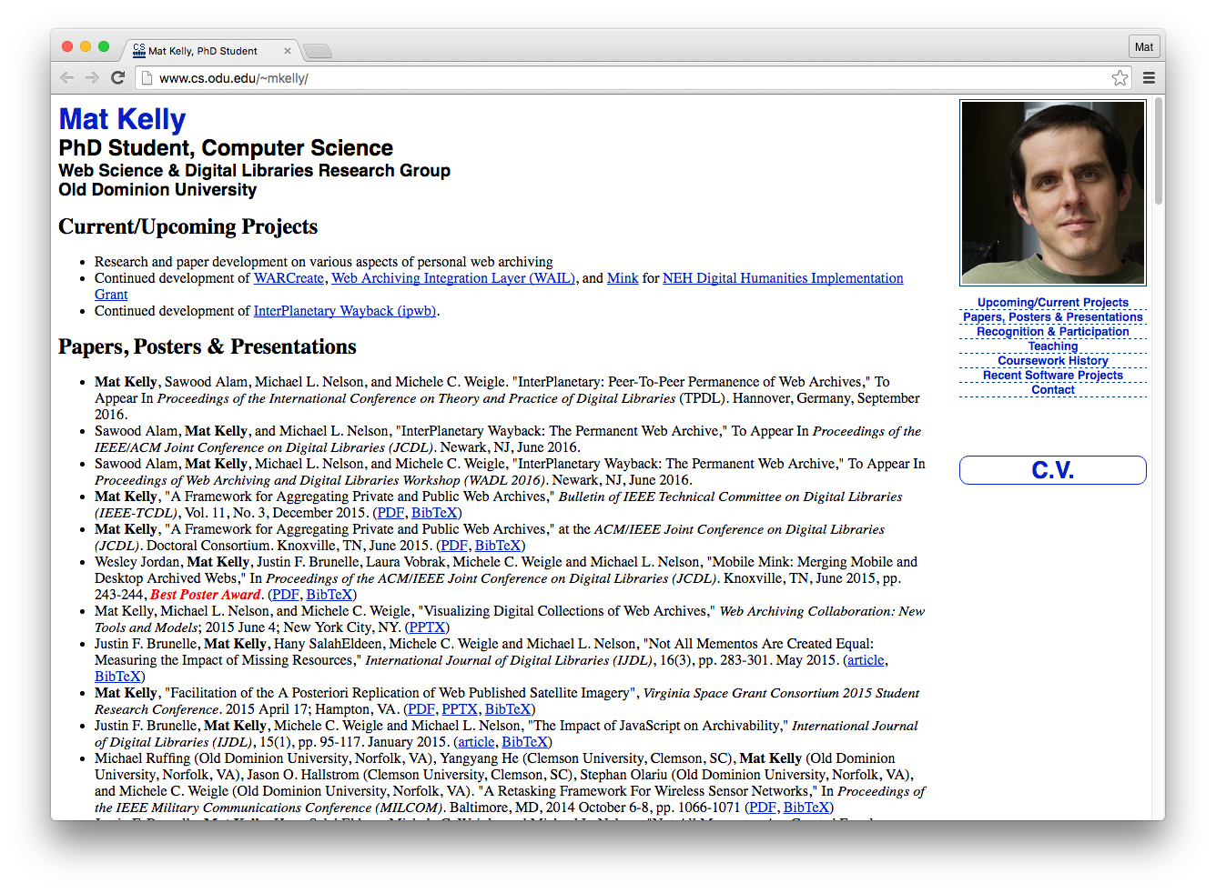
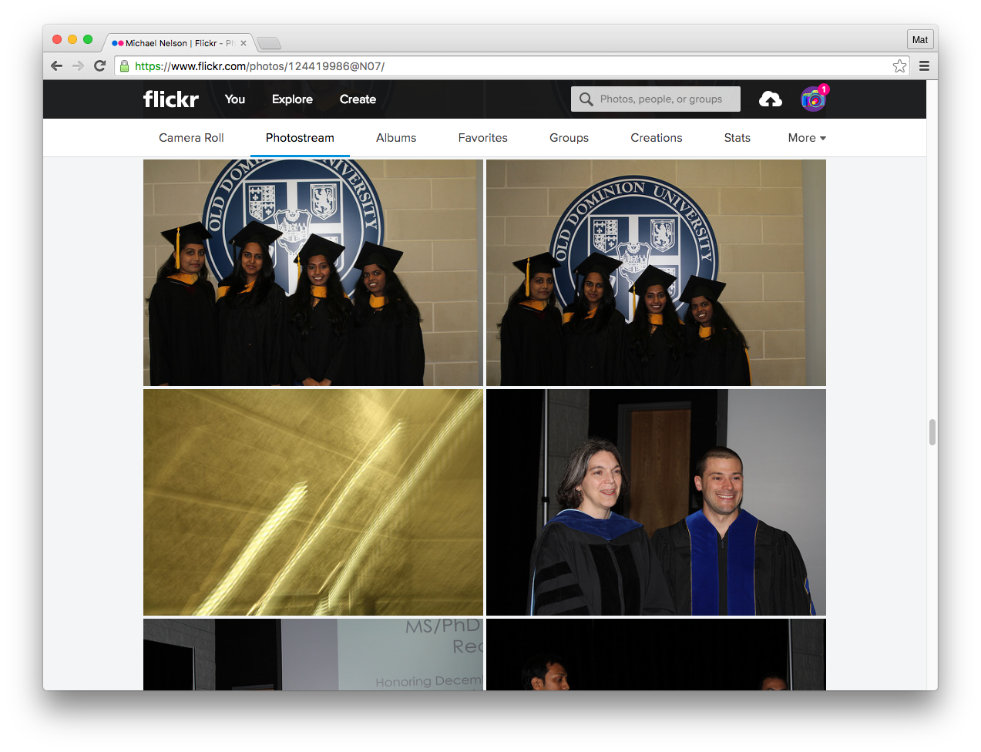
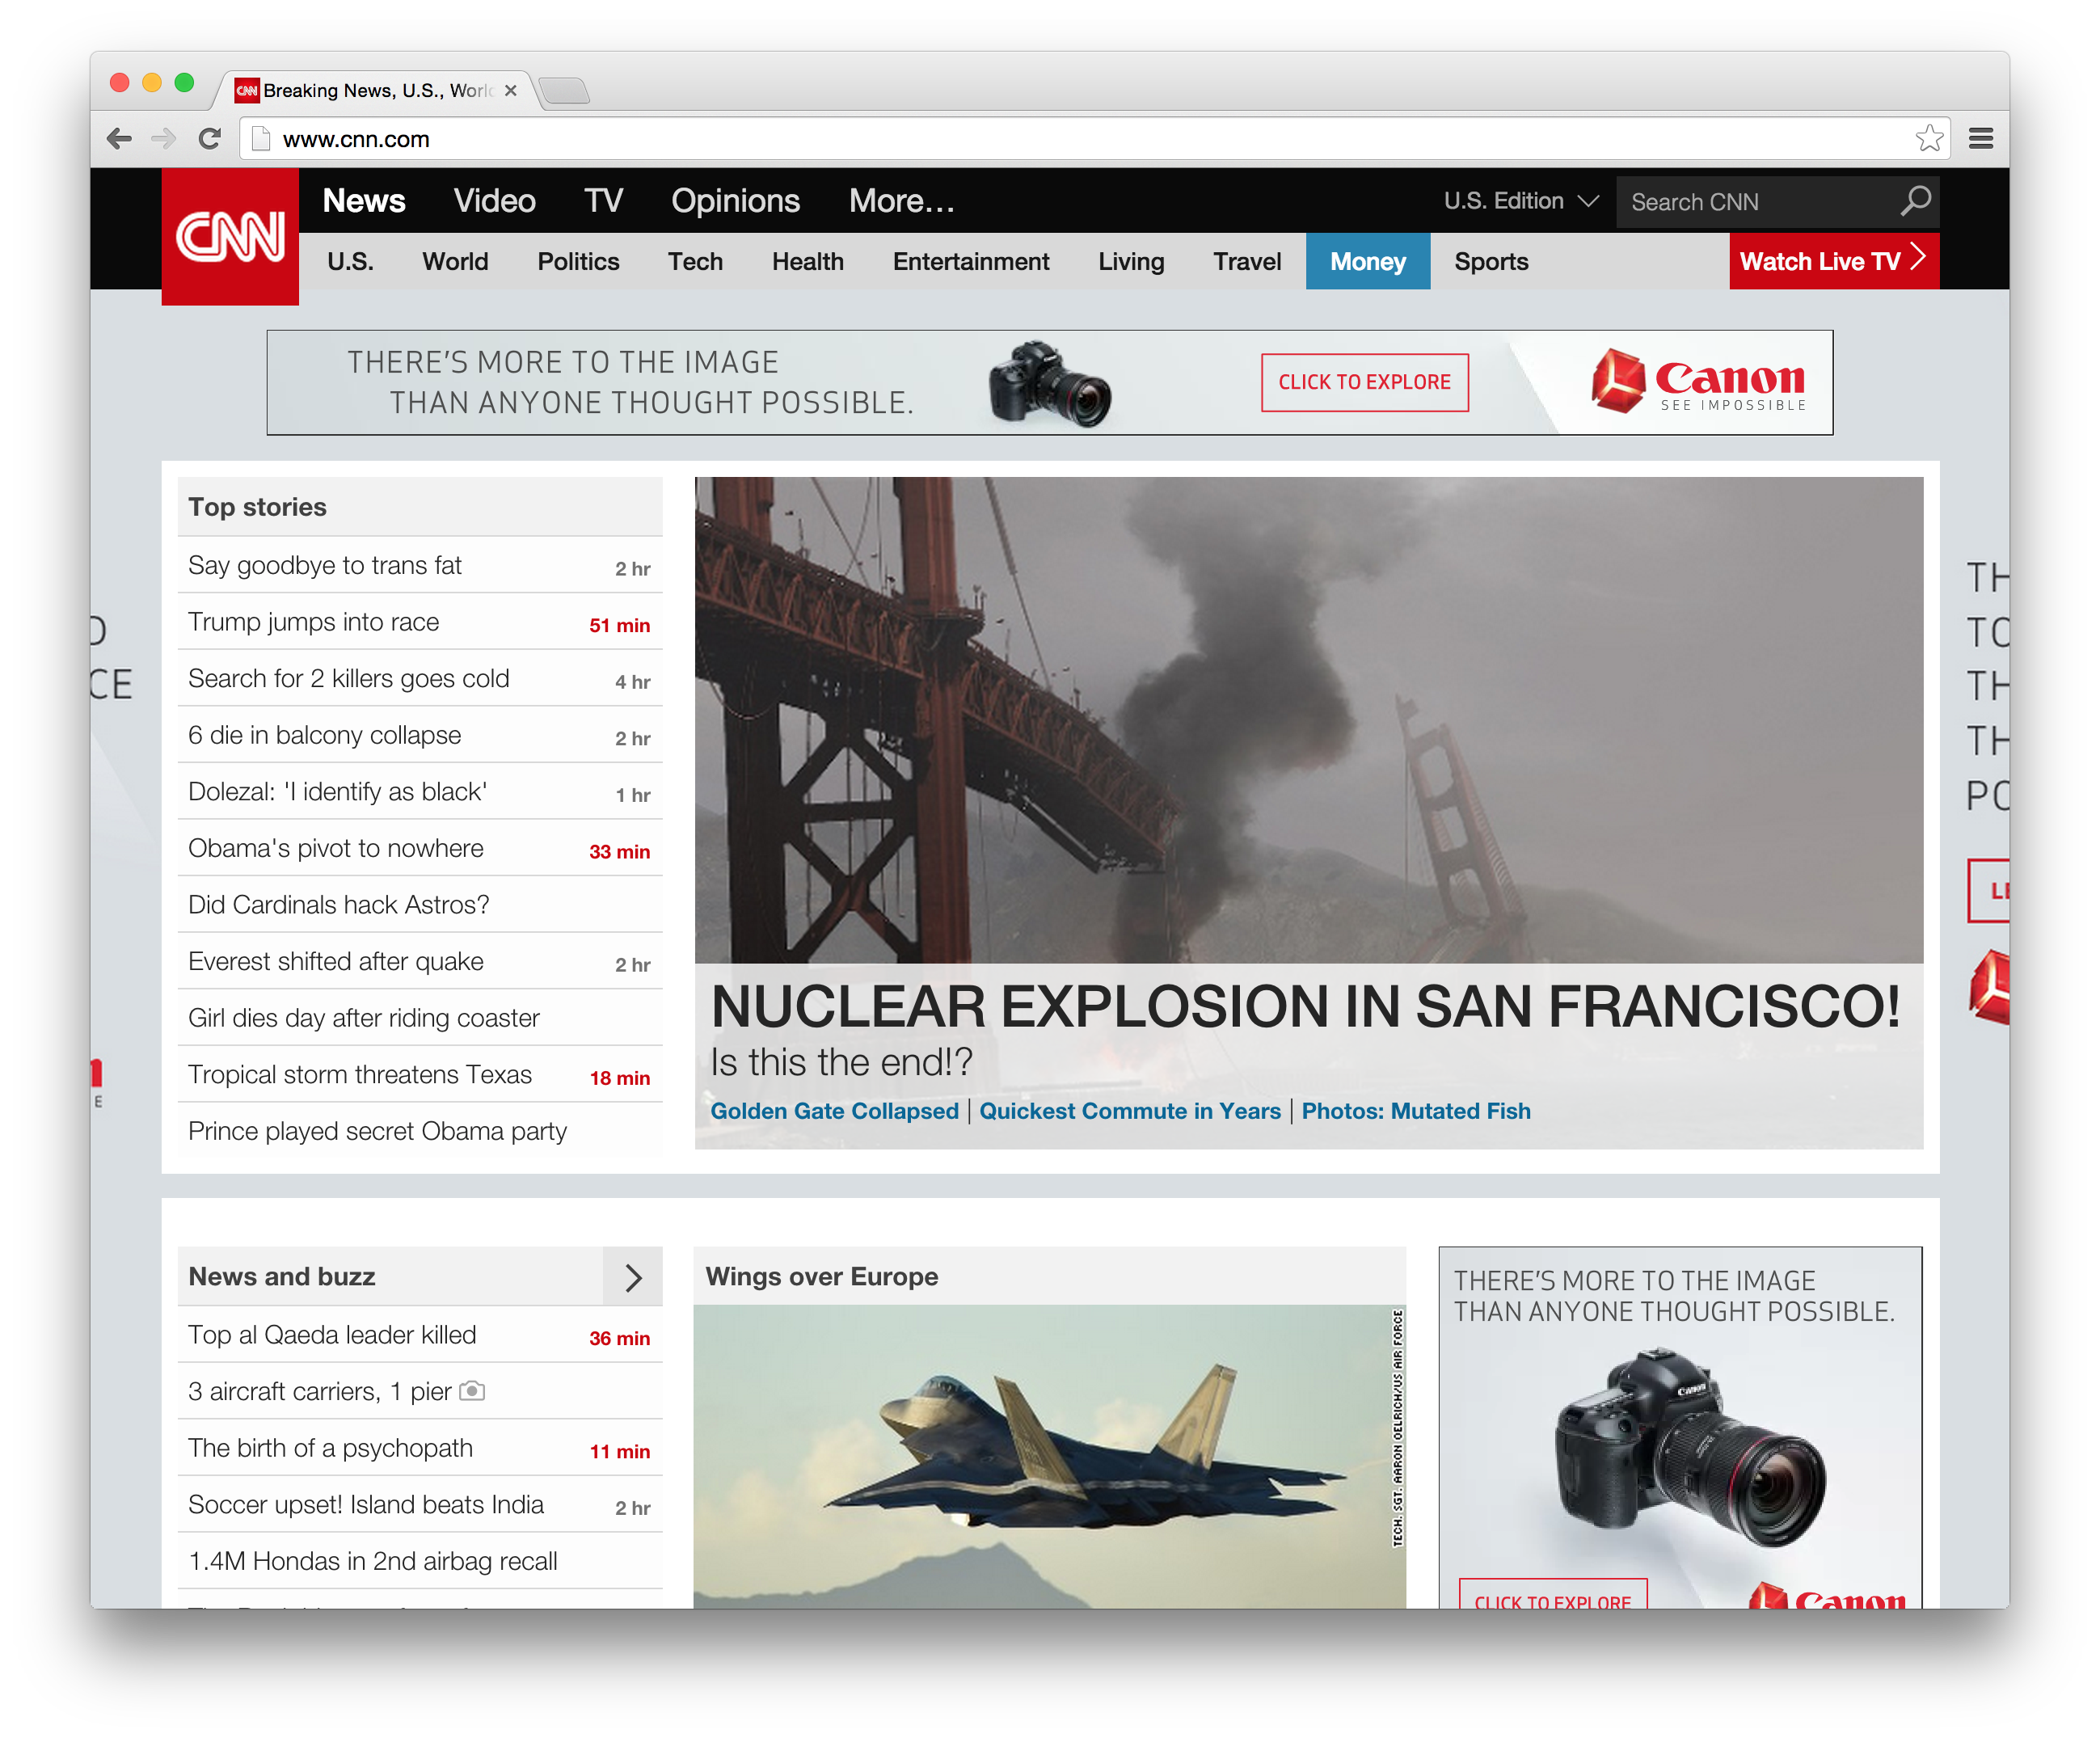
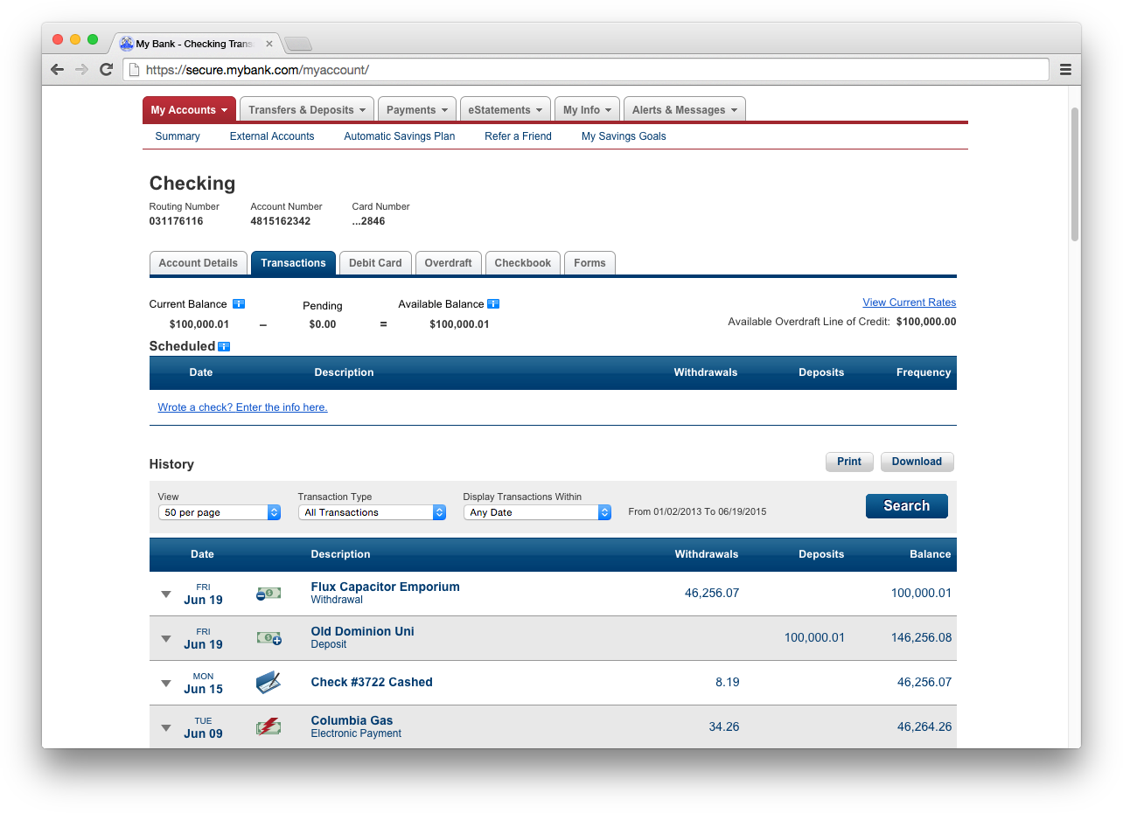


Oh, the things we preserve…
private
archive
Pages I saw or
deem important
For my record
To privately share
180 days ago
2 years ago
10 years ago

Slide 4


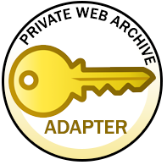
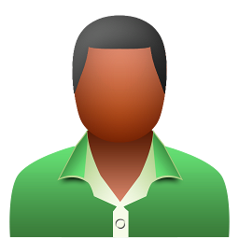

A Framework for Aggregation With Access Control
140 captures
3 captures
10,000 captures
8 captures
140 captures
10
10,151
140
30
3
100
3 captures
10,000
8
MY public CAPTURES
3 captures
10,000
Bob’s Captures
MY BANK CAPTURES
5 captures
10,000 captures
More info:
http://bit.ly/DCdatathon
Alice’s Captures

Slide 5
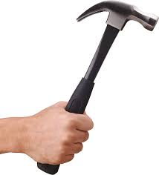
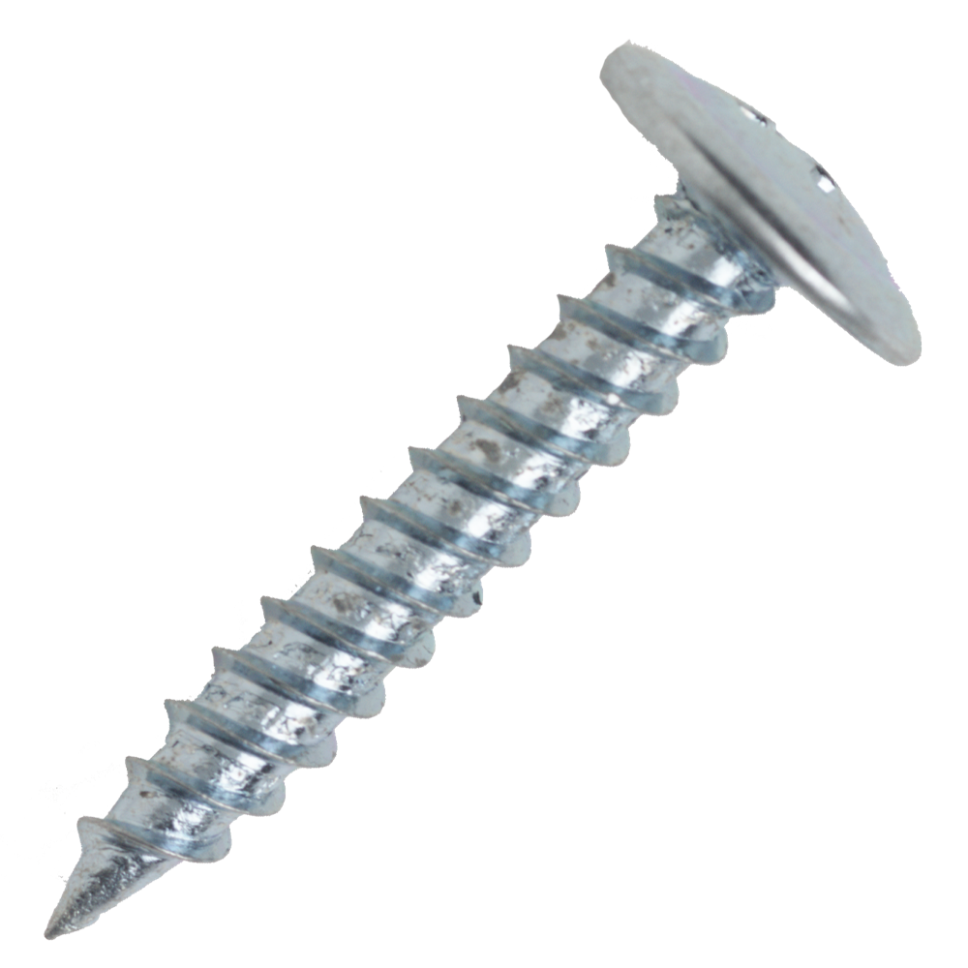

I Need Use Cases!
Send them here!
@machawk1
Concerns with access control of your private web archives?
Past experience where this would be helpful?
Ideas about web archive protection mechanisms?
Exploring Aggregation of Personal, Private, and Institutional Web Archives

